Slide 1

Chapter 9 Session 7
How to use the DOM manipulation and traversal method
Notes:
Session: Ghi số thứ tự session trong môn học
Session Name: ghi tên của session sẽ dạy

Slide 2
Objectives
The DOM manipulation methods
The TOC application
The methods for working with style and positioning
Two event methods used with DOM manipulation
The DOM traversal method
Notes:
Mô tả nội dung mà học viên phải đạt được khi kết thúc môn học này

Slide 3
The DOM manipulation methods
Notes:
Session: Ghi số thứ tự session trong môn học
Session Name: ghi tên của session sẽ dạy

Slide 4
The DOM manipulation methods
The jQuery provides many mothod to help you easier to working with DOM element.
You can use methods of jQuery to change attributes, add, remove an element of DOM.

Slide 5
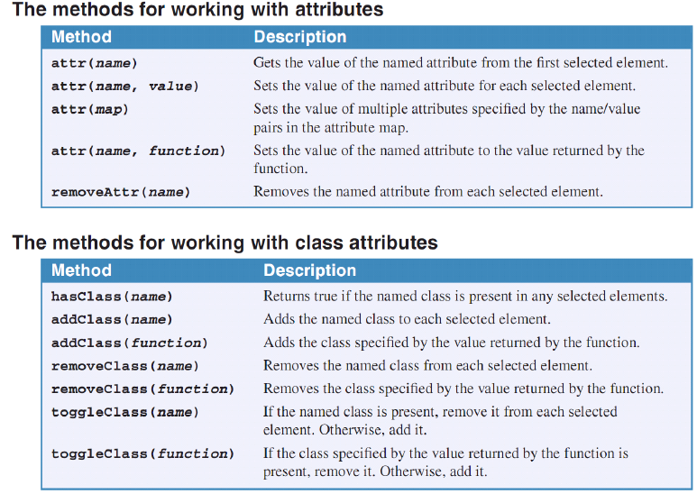
The methods for working with attributes

Slide 6
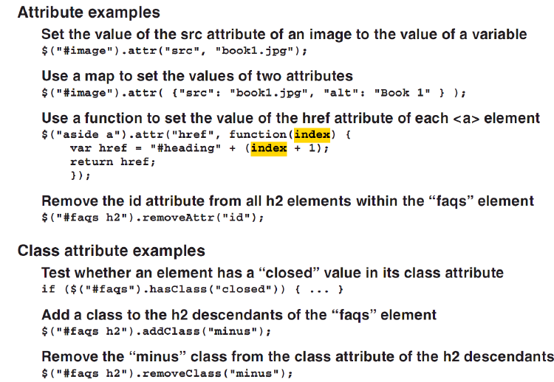
The methods for working with attributes (cont.)

Slide 7
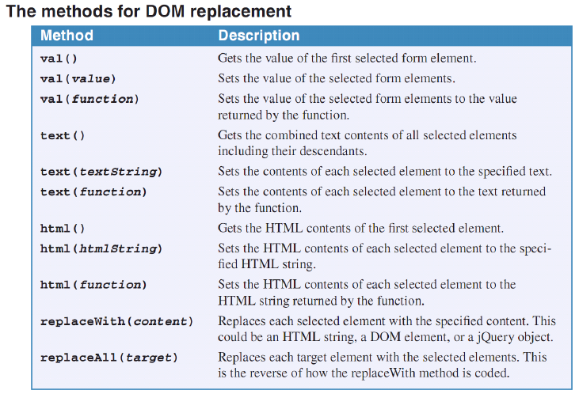
The methods for DOM replacement

Slide 8
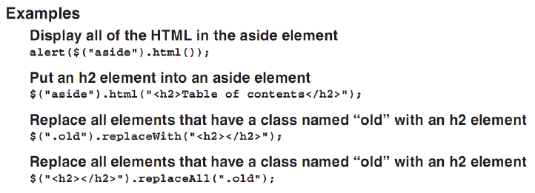
The methods for DOM replacement (cont.)

Slide 9
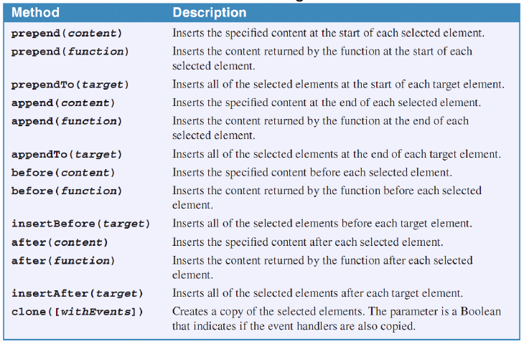
The methods for DOM insertion and cloning

Slide 10
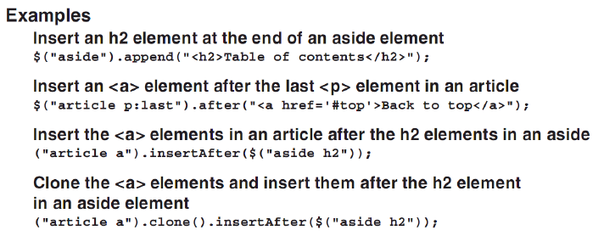
The methods for DOM insertion and cloning (cont.)

Slide 11
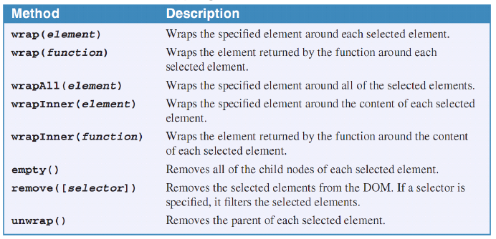
The methods for DOM wraping and removal

Slide 12
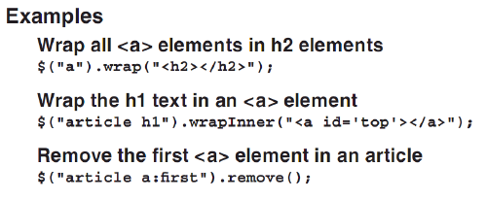
The methods for DOM wraping and removal (cont.)

Slide 13
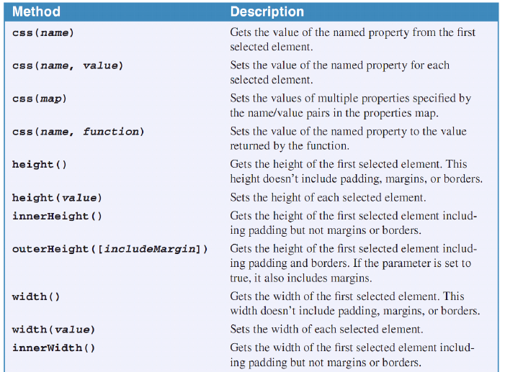


Slide 14
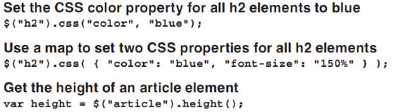
Examples

Slide 15
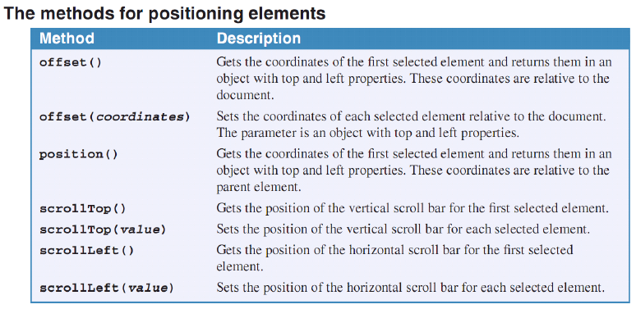
The methods for positioning elements

Slide 16
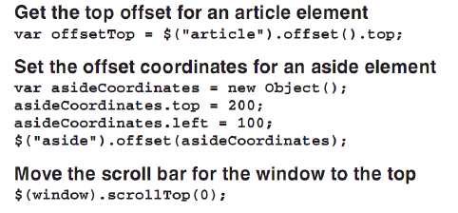
Examples

Slide 17
Event methods used with DOM manipulation
Notes:
Session: Ghi số thứ tự session trong môn học
Session Name: ghi tên của session sẽ dạy

Slide 18
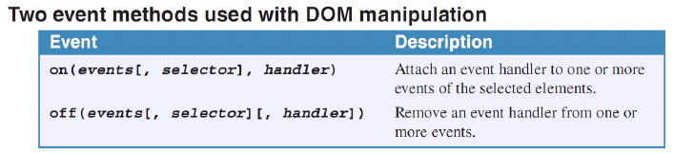
How to use on and off event methods
When you use a shortcut event like click or mouseover to attach an event handler, the on method is used internally in this format:
on(event, event handler)
You can use off event method to remove an event handler that’s attached with either a shortcut method or the on event method.

Slide 19
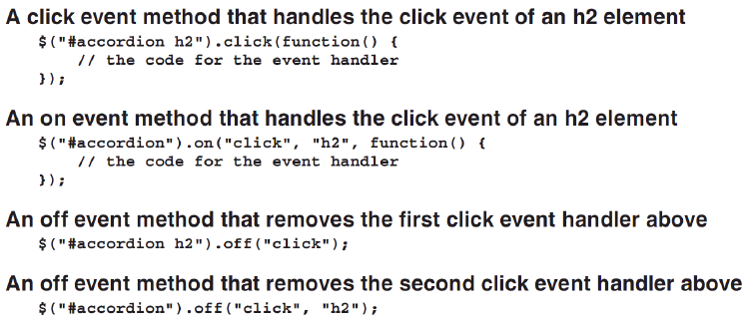
Examples

Slide 20
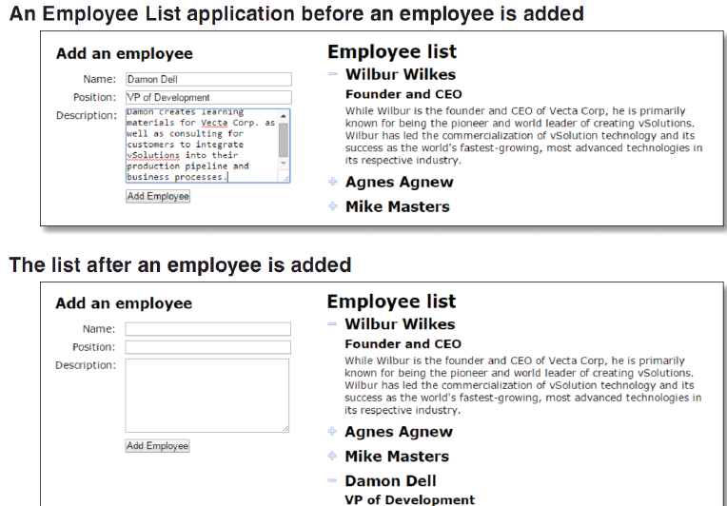
An Employee List application that uses the on method

Slide 21
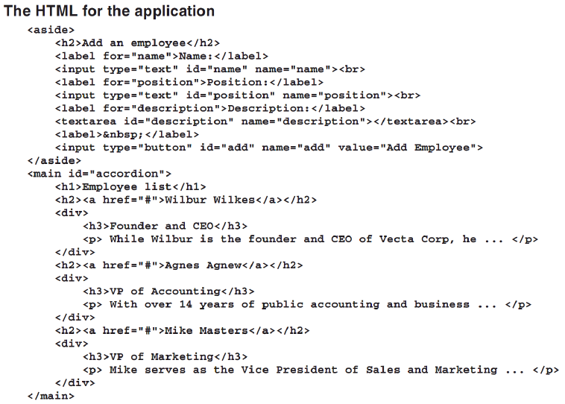

Slide 22
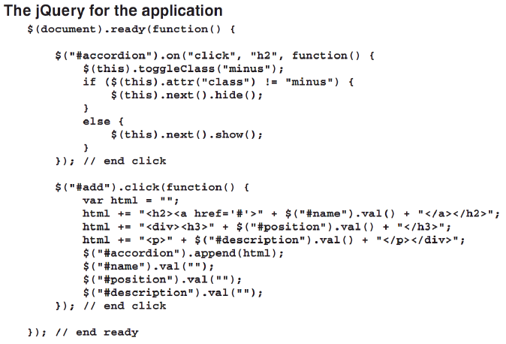

Slide 23
The DOM traversal methods
Notes:
Session: Ghi số thứ tự session trong môn học
Session Name: ghi tên của session sẽ dạy

Slide 24
The DOM traversal methods
The DOM traversal methods make it easier to get any of the elements in the DOM that you want to work with.
There are two types:
The tree traversal methods
The filtering methods

Slide 25
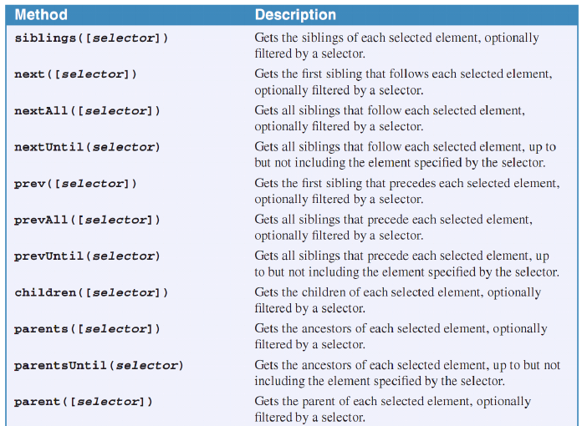
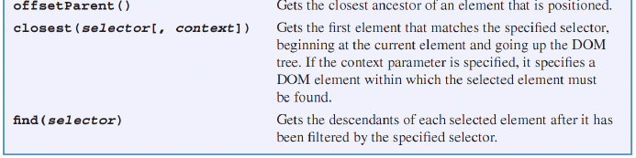
The tree traversal methos

Slide 26
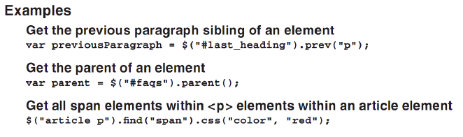
The tree traversal methos (cont.)
The tree traversal methods help you select the siblings, children, parents and ancestors of selected elements in the DOM.

Slide 27
The filtering methods
The benefit of using filtering method is that they facilitate chaining. In practicular, the end method lets you return the object in the chain to the original selection.
If you use a function with the filter or not method, it receives a parameter with the index of the current element in the set.

Slide 28
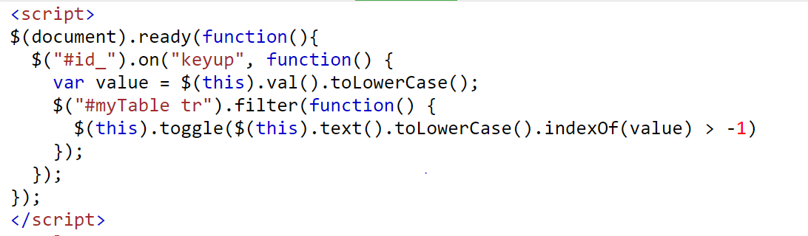

Slide 29
A Slide Show application that uses DOM traversal methods
Notes:
Session: Ghi số thứ tự session trong môn học
Session Name: ghi tên của session sẽ dạy

Slide 30
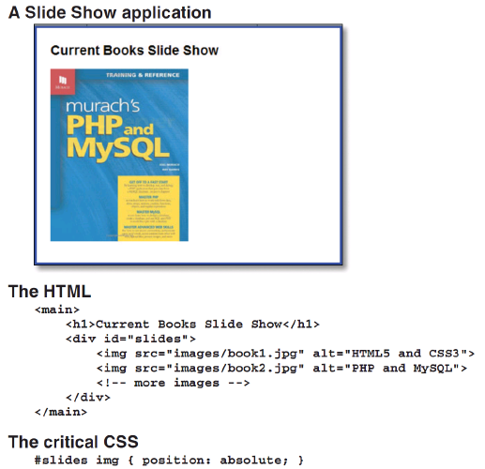

Slide 31
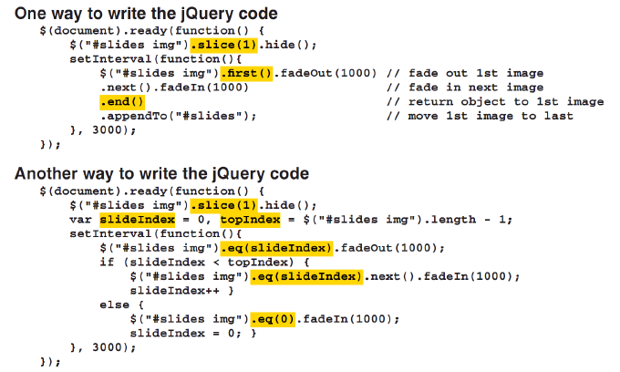
A Slide Show application

Slide 32
Summary
The jQuery provides many mothod to help you easier to working with DOM element.
You can use methods of jQuery to change attributes, add, remove an element of DOM.
You can use on and off event methods to create a handler for an event.
The DOM traversal methods make it easier to get any of the elements in the DOM that you want to work with.
There are two types:
The tree traversal methods
The filtering methods
Notes:
Tóm tắt lại nội dung đã học

Slide 33
The End.

